Slide 1
패션IT팀 시스템 구성도
경영기획실 패션IT팀
2023.11.13
Notes:
For information on applying this template onto existing presentations, refer to the notes on slide 2 of this presentation.
The Input area of the Beam can be customized to reflect the content of the presentation. The Input area is an AutoShape with a picture fill. To change this, ensure you have the image you wish to use (ideally a .jpg or a .png file) in an accessible folder. The image should have a ratio of 1:1 to ensure it does not appear distorted.
Acceptable images for importing into the Input area of the Beam are the three approved graphics (lines), and black and white photography or illustrations which follow the principles laid out on The Branding Zone. Color images should never be imported into this area.
To create a thank you slide with a picture in the Input area of the Beam, duplicate this master slide and create a new master slide. If using the graphic on the title slide the same should be used on the thank you slide. If using a picture in the Input area of the Beam in the title slide, the same or different but related picture can be used on the thank you slide.
Customize the Input area of the Beam as described below.
Click on the View tab from the menu bar and select Master>Slide Master
Right-click on the Input graphic and select Format AutoShape
From the Fill menu, under the Color and Lines tab, click on the drop-down arrow next to Color and select the Fill Effects menu
From the Picture tab, click on Select Picture. Navigate to the folder containing the image you wish to insert in the Input area. Highlight the image and tick the Lock picture aspect ratio box. Click on OK.
You can now preview the image before continuing. If you are happy with how it looks, click Ok to continue. Otherwise, repeat the process until you are happy with your selected image
To exit from Master View, click on View>Normal. The change you made to the Input graphic should now be visible on the title slide

Slide 2


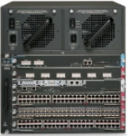
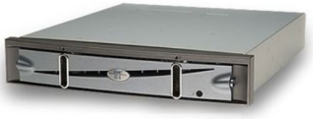

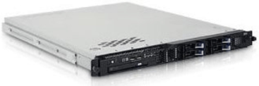
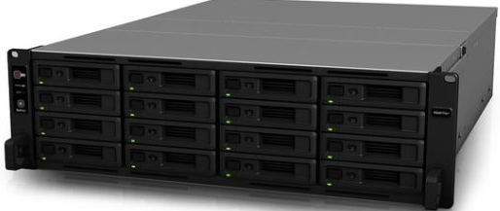
패션영업시스템 서버 구성도
시스템 구성도
패션영업시스템(FONE, AONE) 구성도
Firewall (Active / Standby)
Access Control
Public Switch (Active / Standby)
IP : 221.149.41.X
192.168.20.252
Private Switch (Active / Standby)
= Backbone
Traffic Control
L4 Switch (Active / Standby)
Load Balancing
IP : 192.168.20.50
DB Server (Active / Active)
Data Management
VIP : 150.149.53.10
IP : 150.149.53.12 / 150.149.53.13
NUTANIX Public
Storage Server
Data Storage
WAS Server (Active / Active / Active)
WEB/WAS Service
IP : 192.168.20.51 / 52 / 53

Slide 3
물류관리시스템 구성도
시스템 구성도
물류관리시스템(WMS/WCS) 구성도
남안성 VPN (Active)
Virtual Private Network
WCS DB Server (Active)
MSSQL
IP :150.149.95.10
Firewall (Active / Standby)
Access Control
본사 VPN (Active / Standby)
Virtual Private Network
Public Switch (Active / Standby)
IP : 221.149.41.14
192.168.20.252
Private Switch (Active / Standby)
= Backbone
Traffic Control
천안 VPN (Active)
Virtual Private Network
WCS DB Server (Active)
MSSQL
IP : 150.149.106.10
L4 Switch (Active / Standby)
Load Balancing
IP : 192.168.20.54
WMS DB Server (Active / Standby)
ORACLE
IP : 150.149.53.9
NUTANIX Public
WAS Server (Active / Active)
WEB/WAS Service
IP : 192.168.20.55 / 56
/ 59(Batch)
Storage Server
Data Storage

Slide 4
BW
시스템 구성도
BW 구성도
Firewall (Active / Standby)
Access Control
Public Switch (Active / Standby)
IP : 221.149.41.X
192.168.20.252
Private Switch (Active / Standby)
= Backbone
Traffic Control
DB Server (Active)
Data Management
IP : 150.149.53.1
L4 Switch (Active / Standby)
NUTANIX Public
Storage Server
Data Storage
WAS Server (Active)
WEB/WAS Service
IP : 192.168.20.57

Slide 5
S-인사
시스템 구성도
S-인사 구성도
Firewall (Active / Standby)
Access Control
Public Switch (Active / Standby)
IP : 221.149.41.X
192.168.20.252
Private Switch (Active / Standby)
= Backbone
Traffic Control
DB Server (Active)
Data Management
IP : 150.149.53.1
L4 Switch (Active / Standby)
NUTANIX Public
Storage Server
Data Storage
WAS Server (Active)
WEB/WAS Service
IP : 192.168.20.58

